Slide 1
Data Visualisation in Big Data

Slide 2
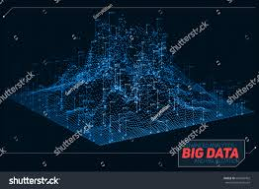
Data visualization is the presentation of data in a pictorial or graphical
format.
It enables decision
makers to see analytics
presented visually, so they
can grasp difficult concepts or identify new patterns.

Slide 3
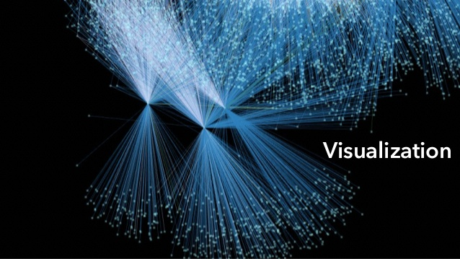
With interactive visualization,
you can take the concept a step
further by using technology to drill
down into charts and graphs for
more detail, interactively changing
what data you see and how it’s
processed.

Slide 4
Why is data visualization important?
Because of the way the human brain processes information, using charts or graphs to visualize large amounts of complex data is easier than poring over spreadsheets or reports.

Slide 5
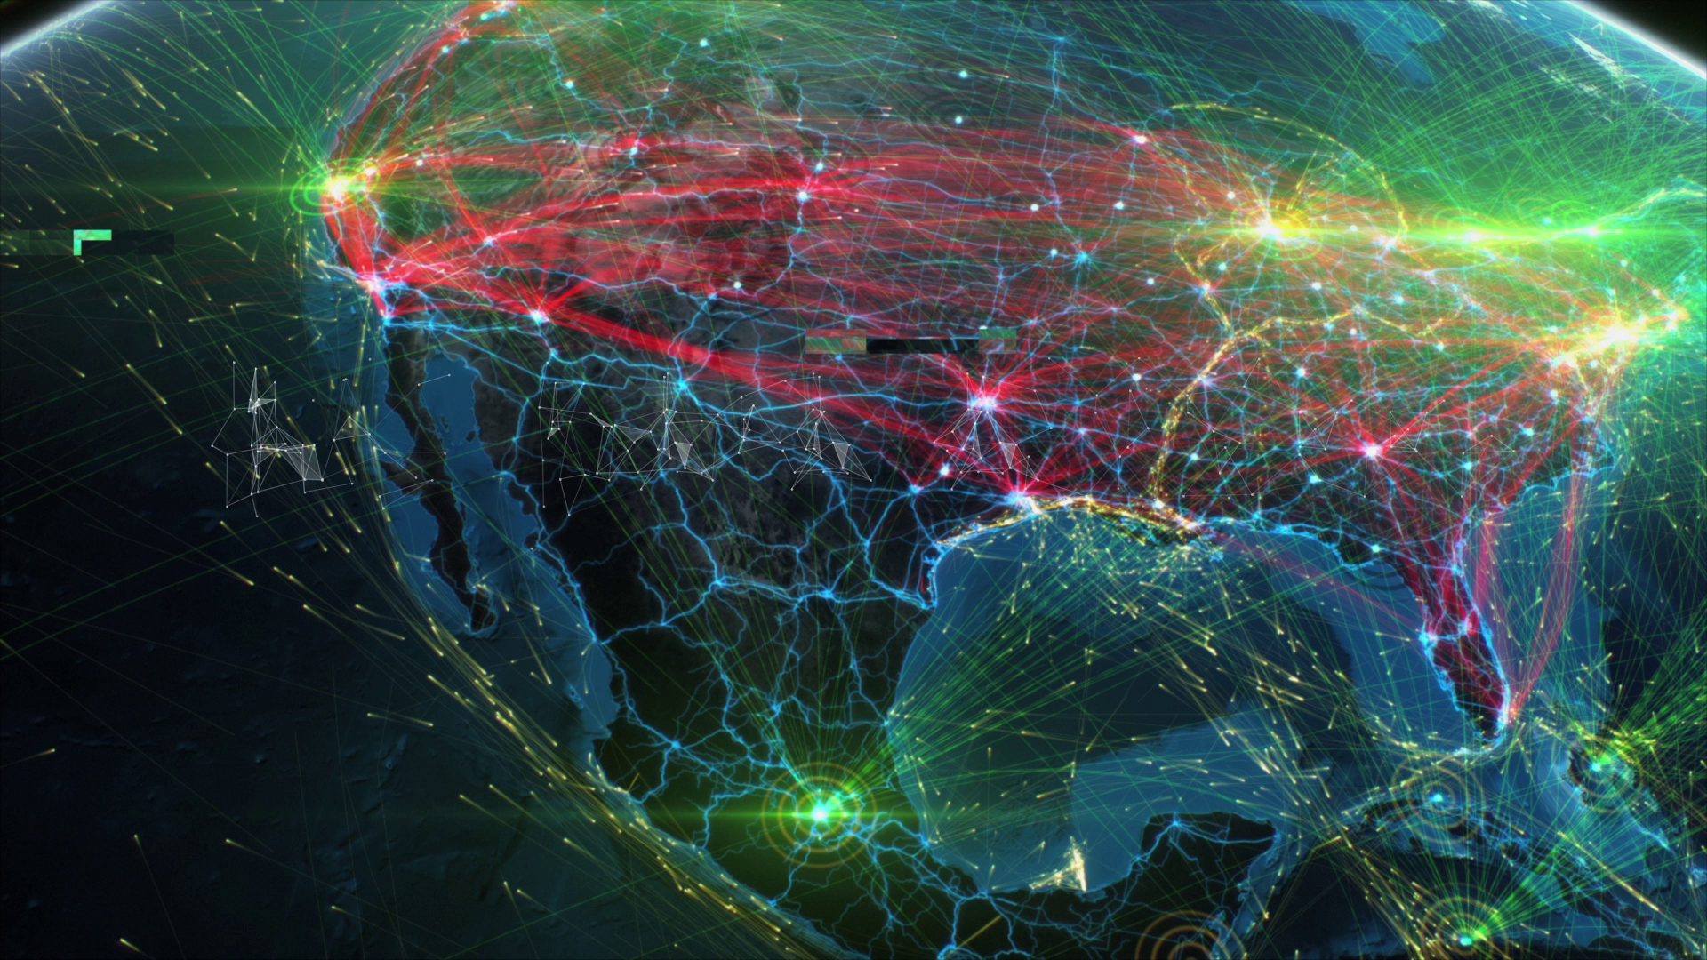
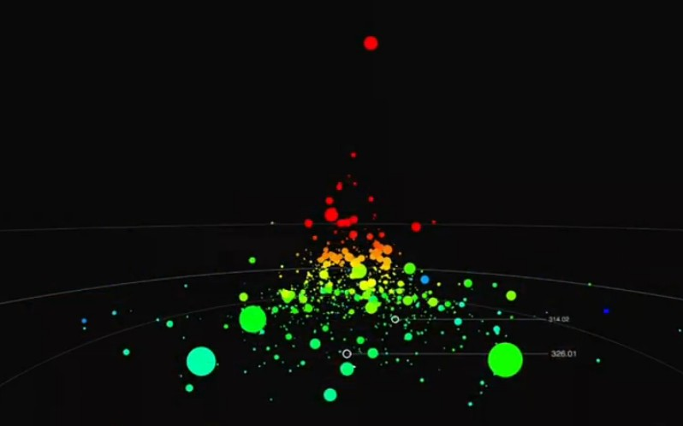
Data visualization is a quick, easy way to convey concepts in a universal manner – and you can experiment with different scenarios by making slight adjustments.

Slide 6
Data visualization can also:
Identify areas that need attention or improvement.
Clarify which factors influence customer behavior.
Help you understand which products to place where.
Predict sales volumes.

Slide 7
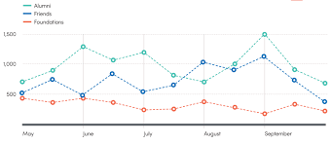
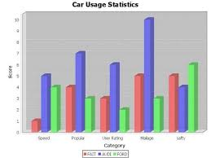
Data Visualisation Methods
Line Graph Bar Chart

Slide 8
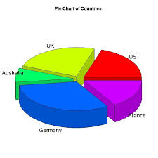
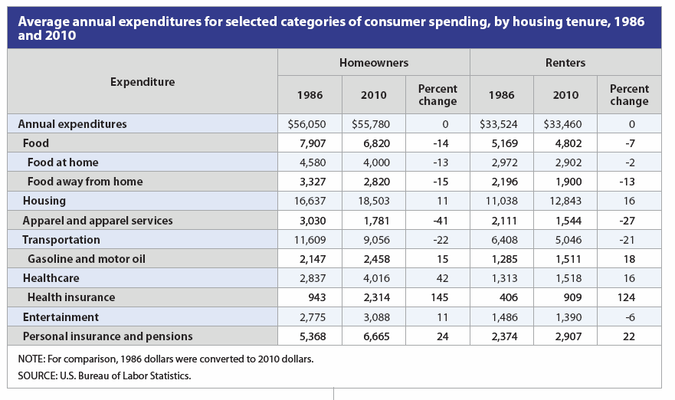
Pie Chart Table

Slide 9
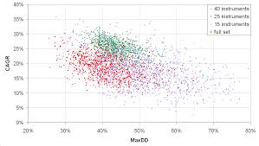
Scatter Plots:
A scatter plot is described as a
2-dimensional plot which displays
the joint variation of two data items.
Scatter plots can help you know
how the data points are scattered
or spread across the graph and
also you will know how well they
are closely related.

Slide 10
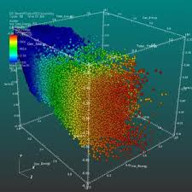
Multi-dimensional Scatter Plots:

Slide 11
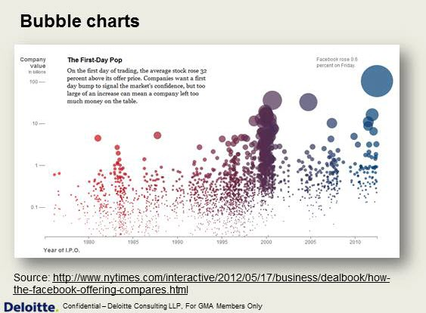
Bubble Chart:
It shows the relationship that
exists between the minimum of
three variables. Two of them gets
represented by the plot axes i.e.
x-axis and y-axis, while the third
one by the bubble size.
Colors are being used to
represent an additional measure
and the bubbles could be subjected to animation in order to show data changes over a period of time.

Slide 12
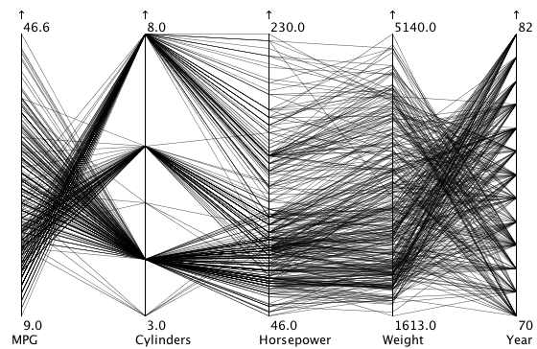
Parallel Coordinates:
The parallel coordinate
technique makes use of the
concept of networking a
multi-dimensional point to
some axes and all of these
are parallel to each other.
The parallel coordinate is
important if you want to show
a multidimensional data and a lot of these dimensions are being organized and expanded by this technique.

Slide 13
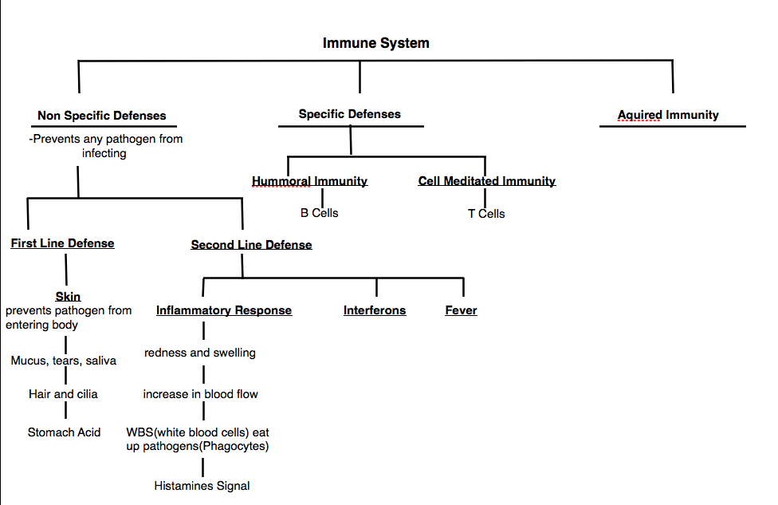
Tree Map:
A tree map is a visualizing
technique that has the
attribute of showing data in
hierarchy in a nested or
layered rectangle form.
User are able to compare
nodes at different depth and
also they are able to identify
expected results and patterns.

Slide 14
Key features of Data Visualisation Techniques:
Allows users to share and collaborate securely.
They give room for real time data analysis.
It holds data in-memory, where it is accessible to multiple users.
Support online creation of dynamic, interactive presentations and reports.

Slide 15
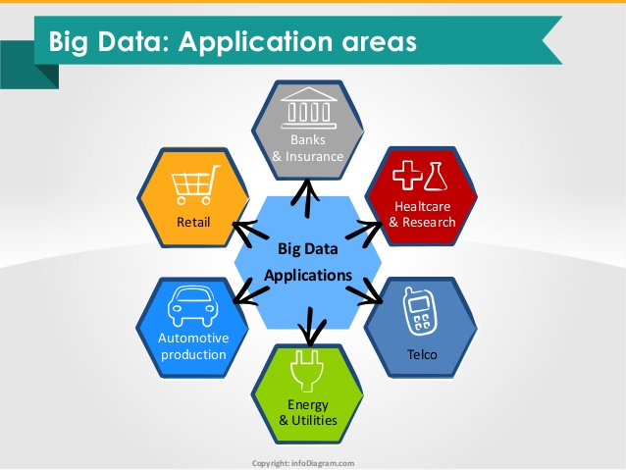
Intelligent Data Analytics Applications

Slide 16
Applications Of Data Analytics:
Healthcare
Data analytics is used to identify best practices that improve healthcare and reduce costs.
Processes are developed that make sure that the patients receive appropriate care at the right place and at the right time.
Data mining can also help healthcare insurers to detect fraud and abuse.

Slide 17
Customer Relationship Management
Customer Relationship Management is all about acquiring and retaining customers, also improving customers’ loyalty and implementing customer focused strategies.
With data mining technologies the collected data can be used for analysis.
Instead of being confused where to focus to retain customer, the seekers for the solution get filtered results.

Slide 18
Finance and banking
Data mining can contribute to solving business problems in banking and finance by finding patterns, causalities, and correlations in business information and market prices that are not immediately apparent to managers because the volume data is too large or is generated too quickly to screen by experts.
The managers may find these information for better segmenting,targeting, acquiring, retaining and maintaining a profitable customer.

Slide 19
Intrusion Detection
Any action that will compromise the integrity and confidentiality of a resource is an intrusion.
Data mining can help improve intrusion detection by adding a level of focus to anomaly detection.
It helps an analyst to distinguish an activity from common everyday network activity.
Data mining also helps extract data which is more relevant to the problem.

